Slide 1
Foundation Day
1st Foundation Day-10th Foundation Day

Slide 2
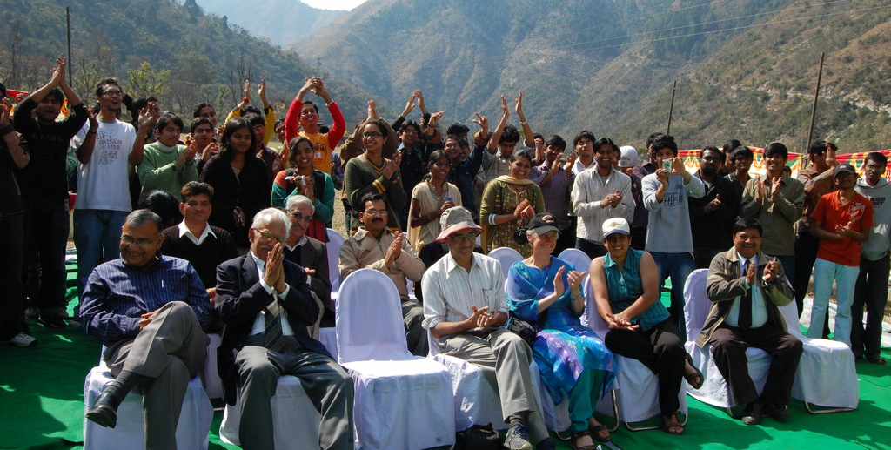
1st Foundation Day-2010
IIT Mandi Campus community

Slide 3
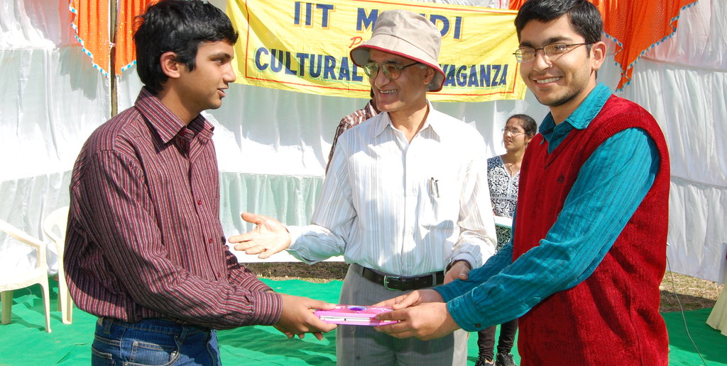
1st Foundation Day-2010
Prize distribution By Prof. Timothy A. Gonsalves (Director, IIT Mandi)

Slide 4
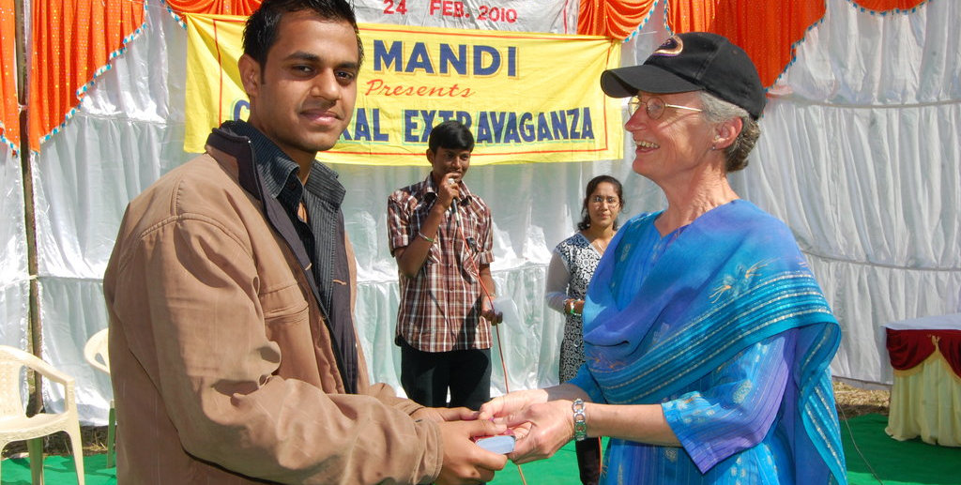
1st Foundation Day-2010
Prize distribution by Dr. Priscilla Gonsalves

Slide 5
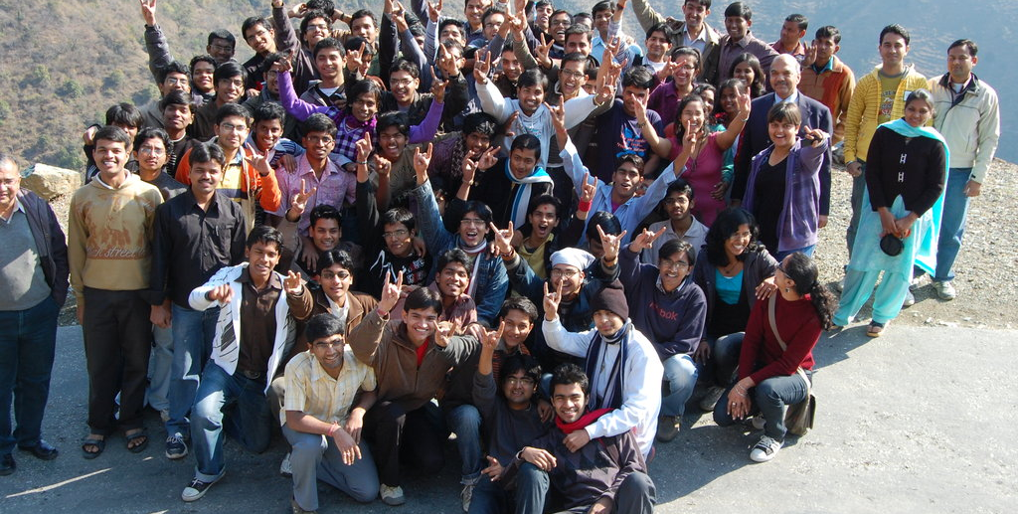
1st Foundation Day-2010
Group Picture of Student, Faculty and Staff

Slide 6
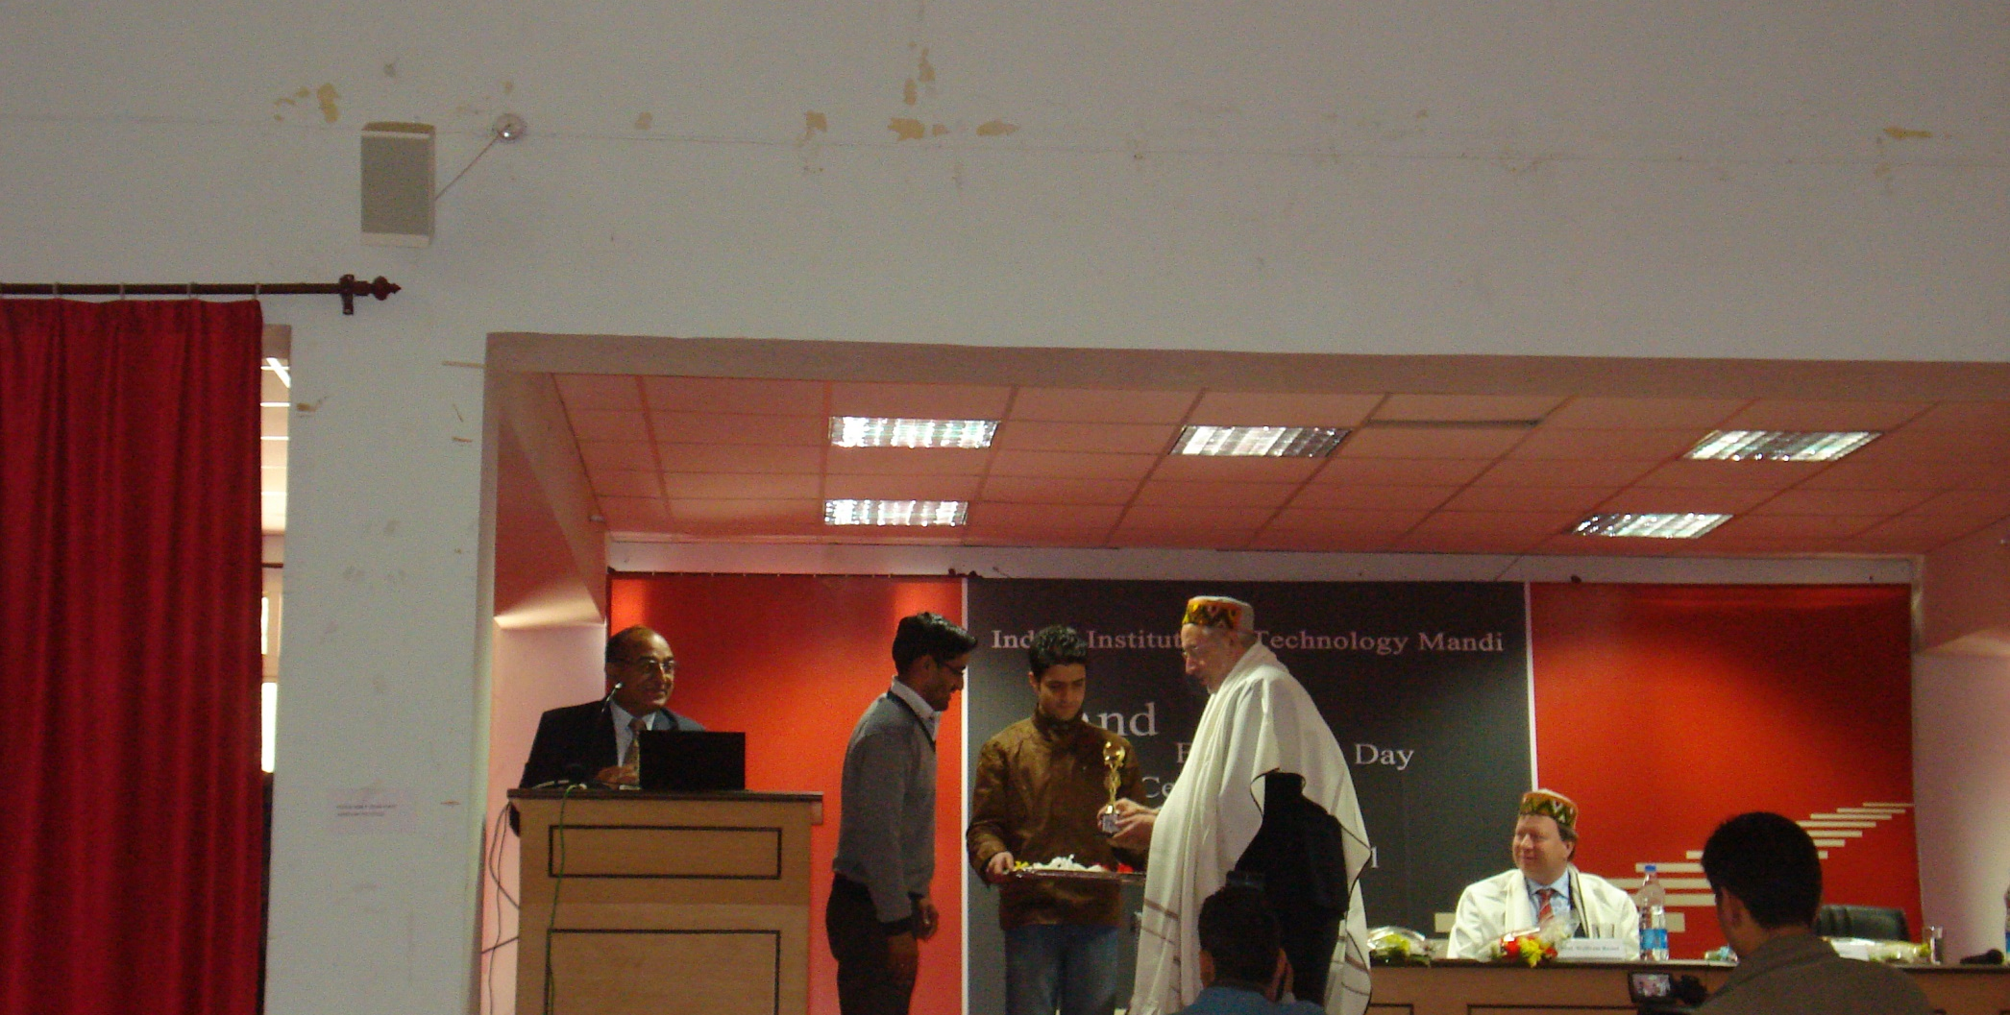
2nd Foundation Day-2011
Mr. Rajat Sharma (JE,Civil) receiving award from Dr. David Phillips

Slide 7
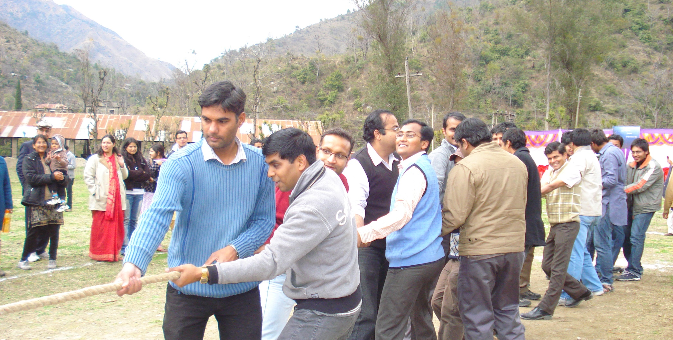
2nd Foundation Day-2011
Tug-of-War between Students and Faculty

Slide 8
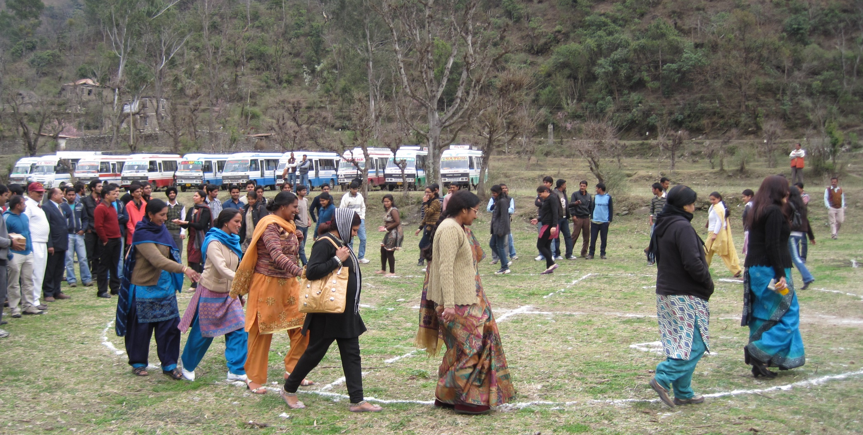
2nd Foundation Day-2011
Game- IIT Mandi Faculty and staff

Slide 9
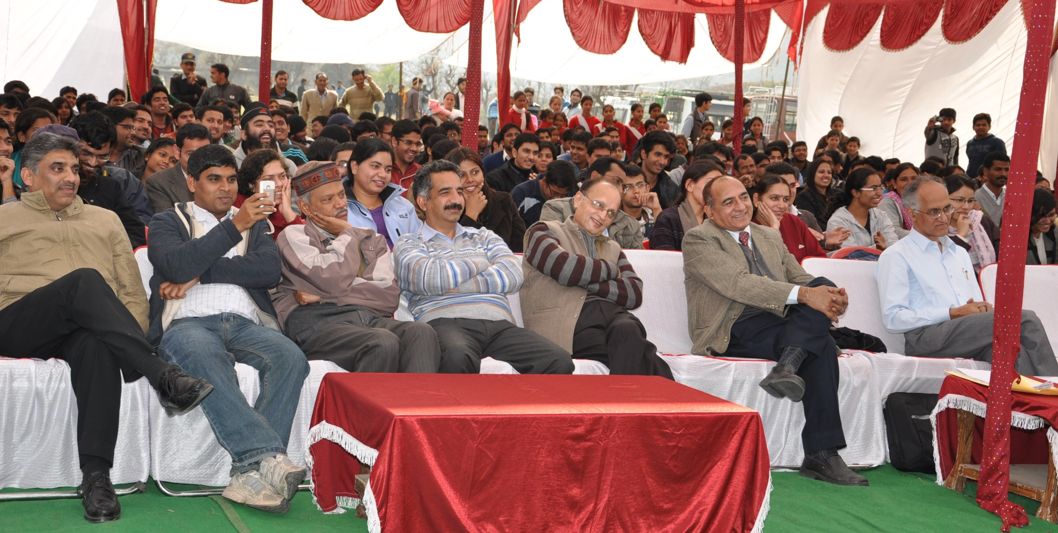
3rd Foundation Day-2012
IIT Mandi Campus Community

Slide 10
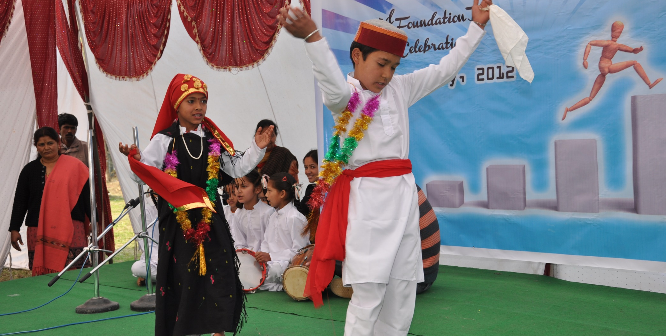
3rd Foundation Day-2012
Cultural Program

Slide 11
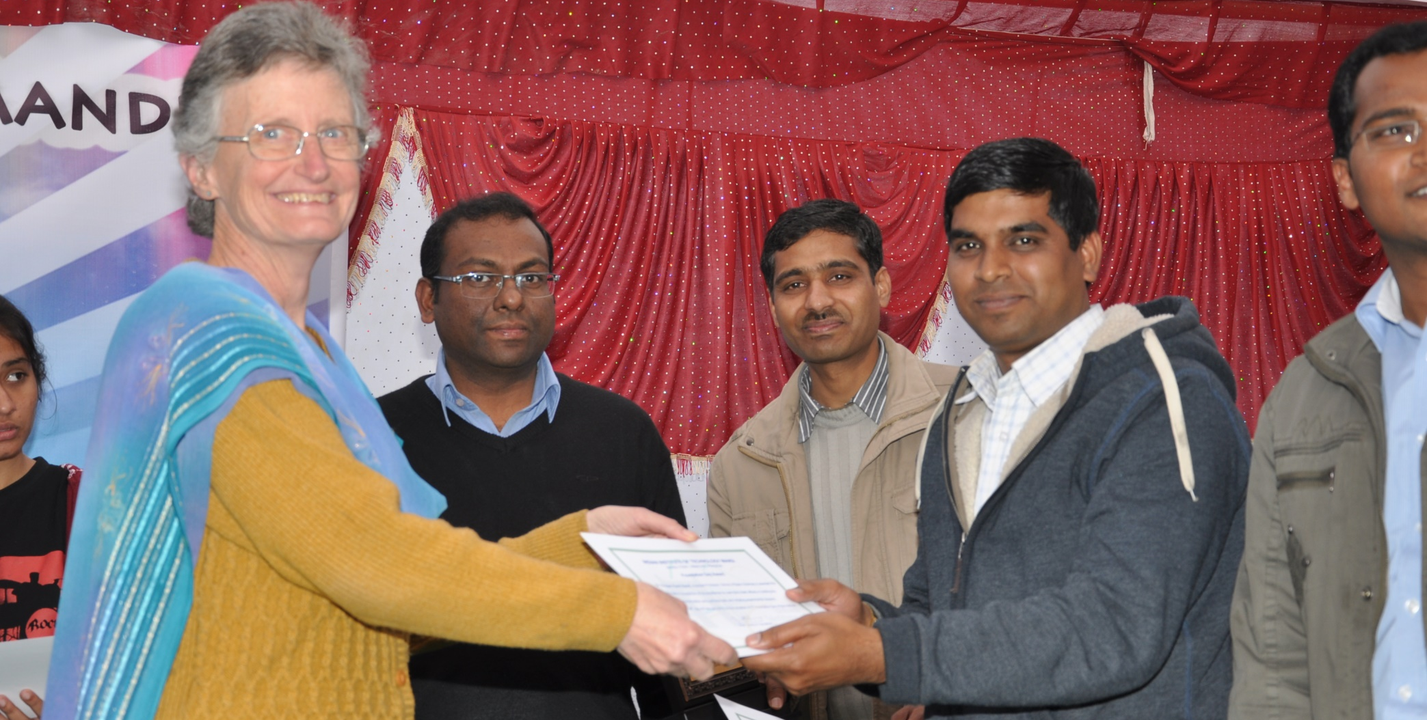
3rd Foundation Day-2012
Prize distribution by Dr. Priscilla Gonsalves

Slide 12
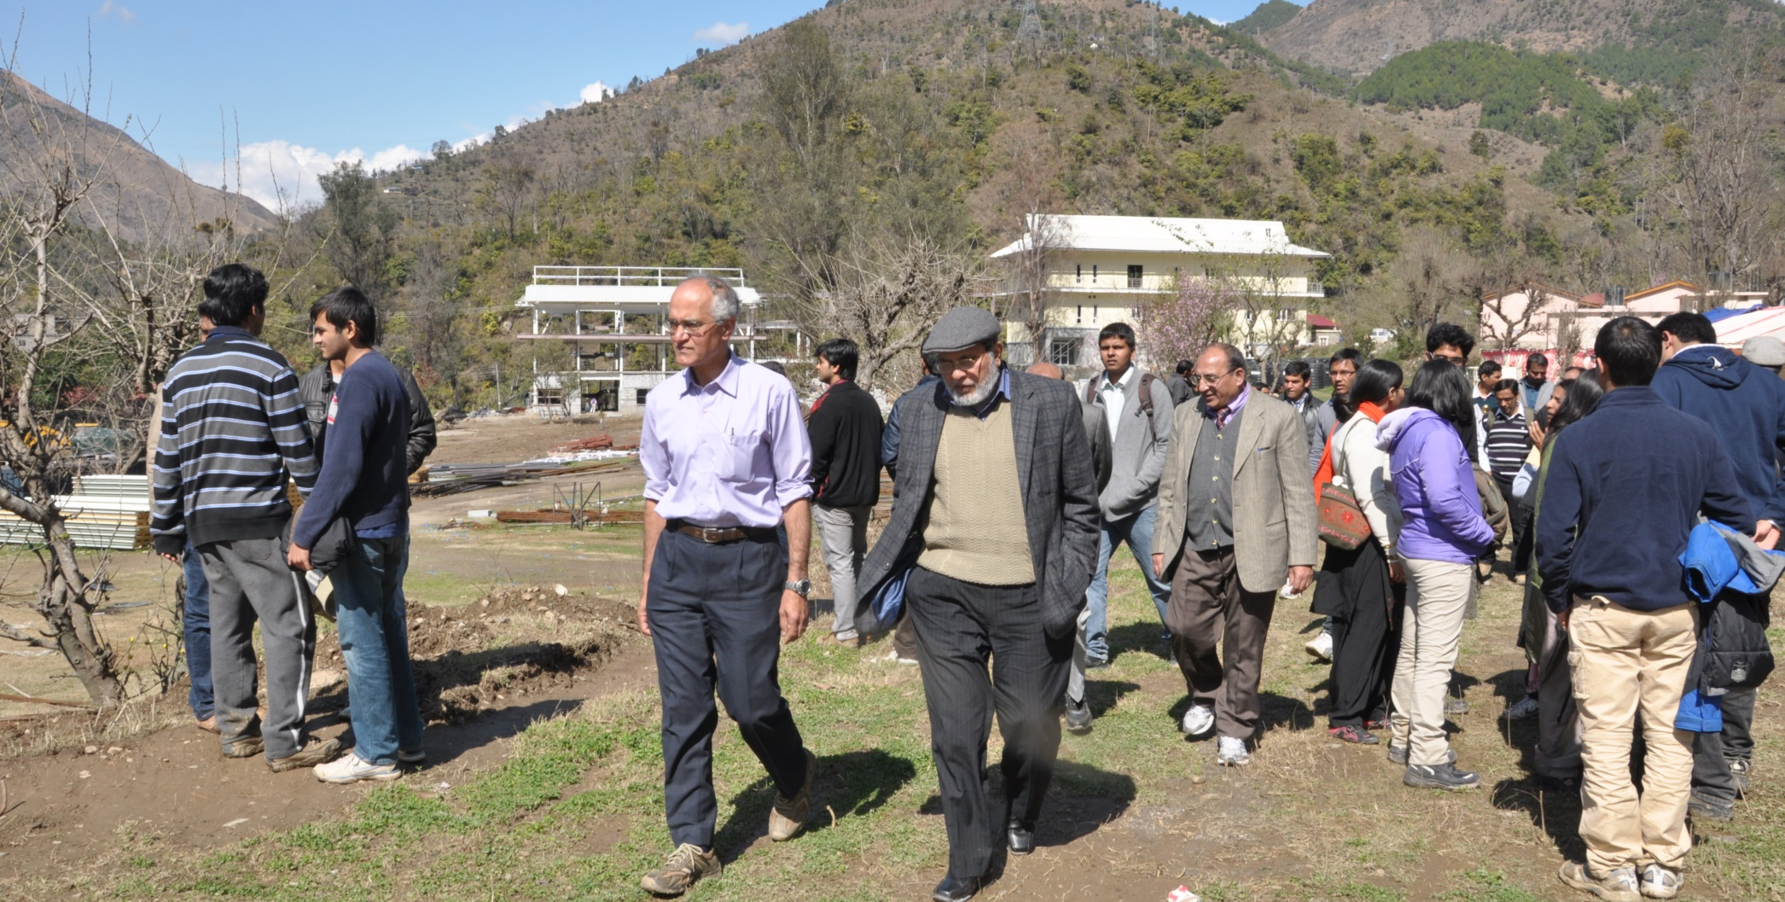
4th Foundation Day-2013
Walking in Campus-Prof. Timothy A. Gonsalves(Director, IIT Mandi), Faculty ,staff and Students

Slide 13
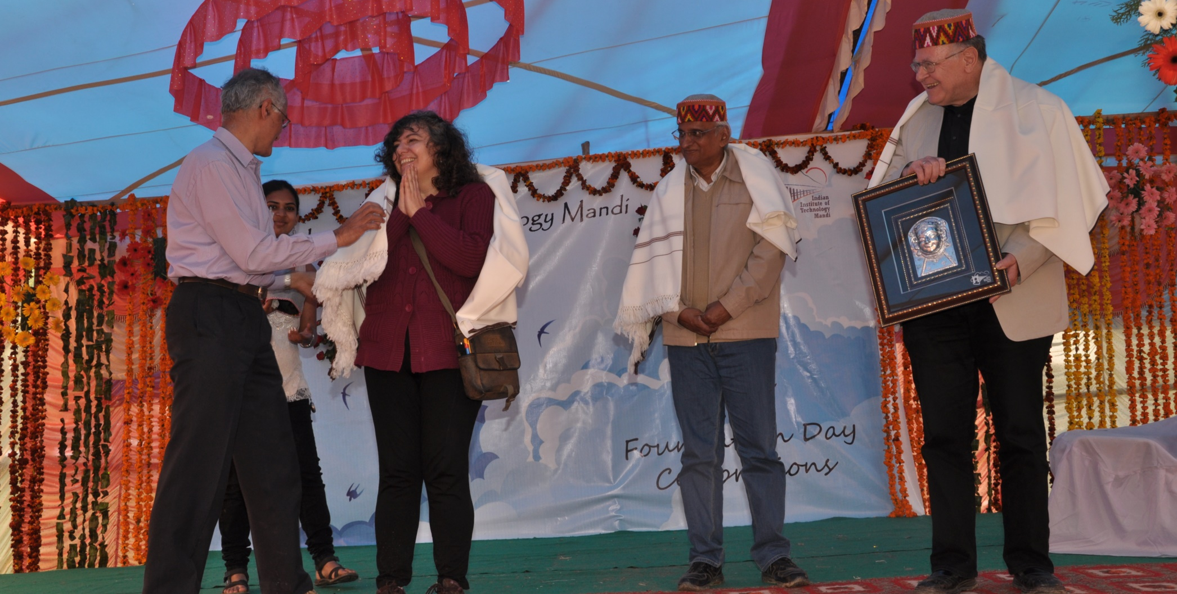
4th Foundation Day-2013
L-R Prof. Timothy A. Gonsalves felicitating Dr. Paola Di Maio with a traditional Himachali shawl, Prof. Ramesh Oruganti, Dr. H. Schweppe (Chief Guest)

Slide 14
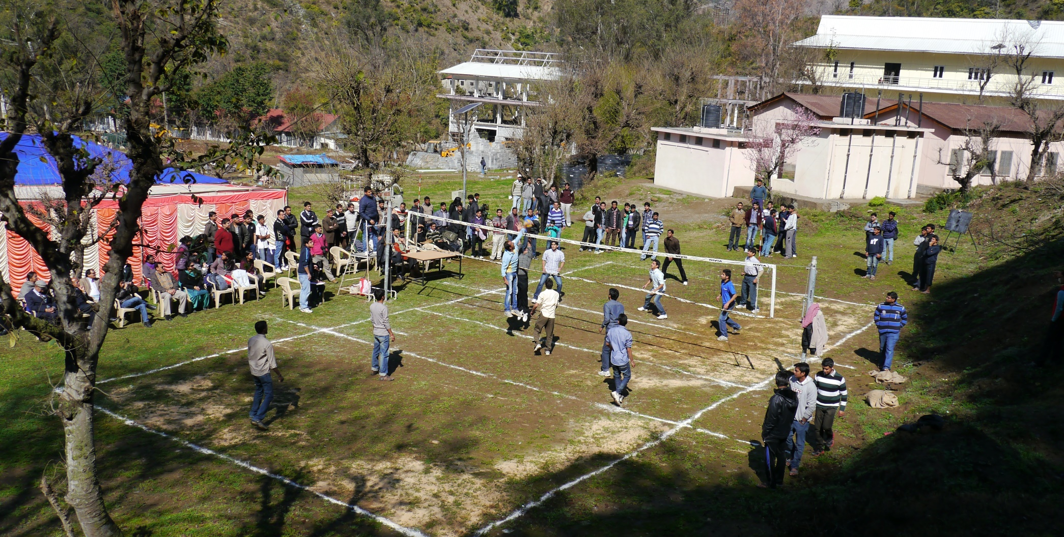
4th Foundation Day-2013
Volleyball Match

Slide 15
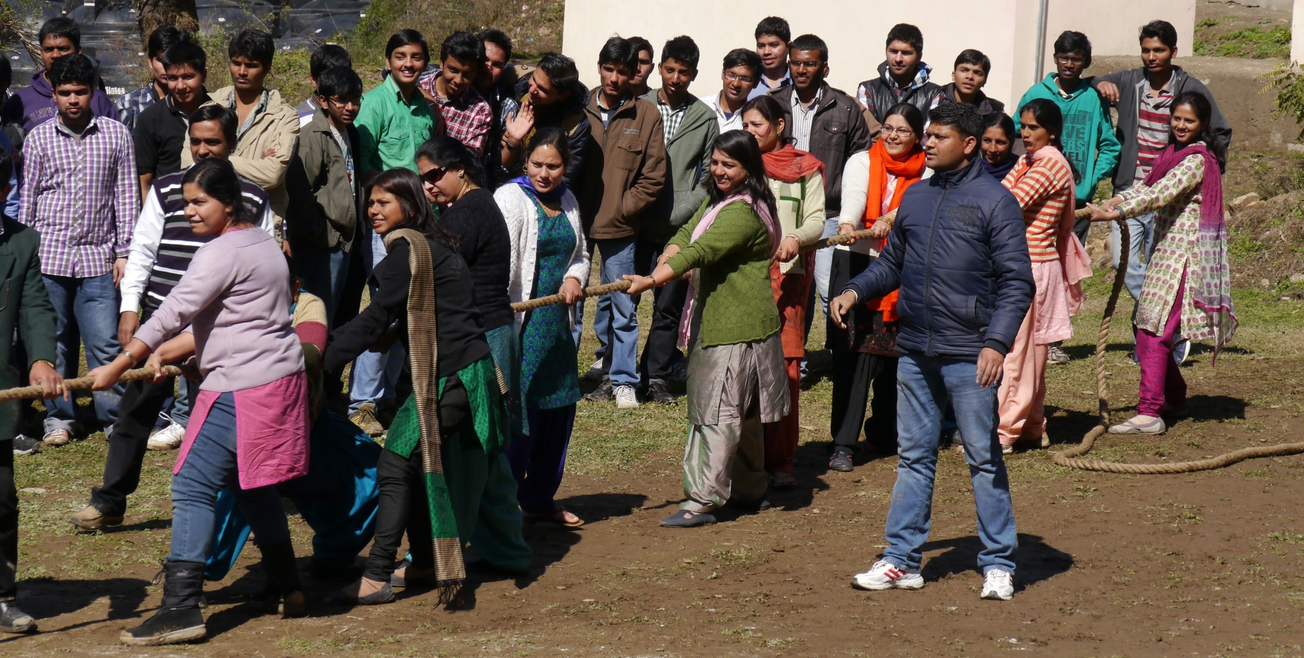
4th Foundation Day-2013
Tug-of-War between IIT Mandi Female Faculty and Students

Slide 16
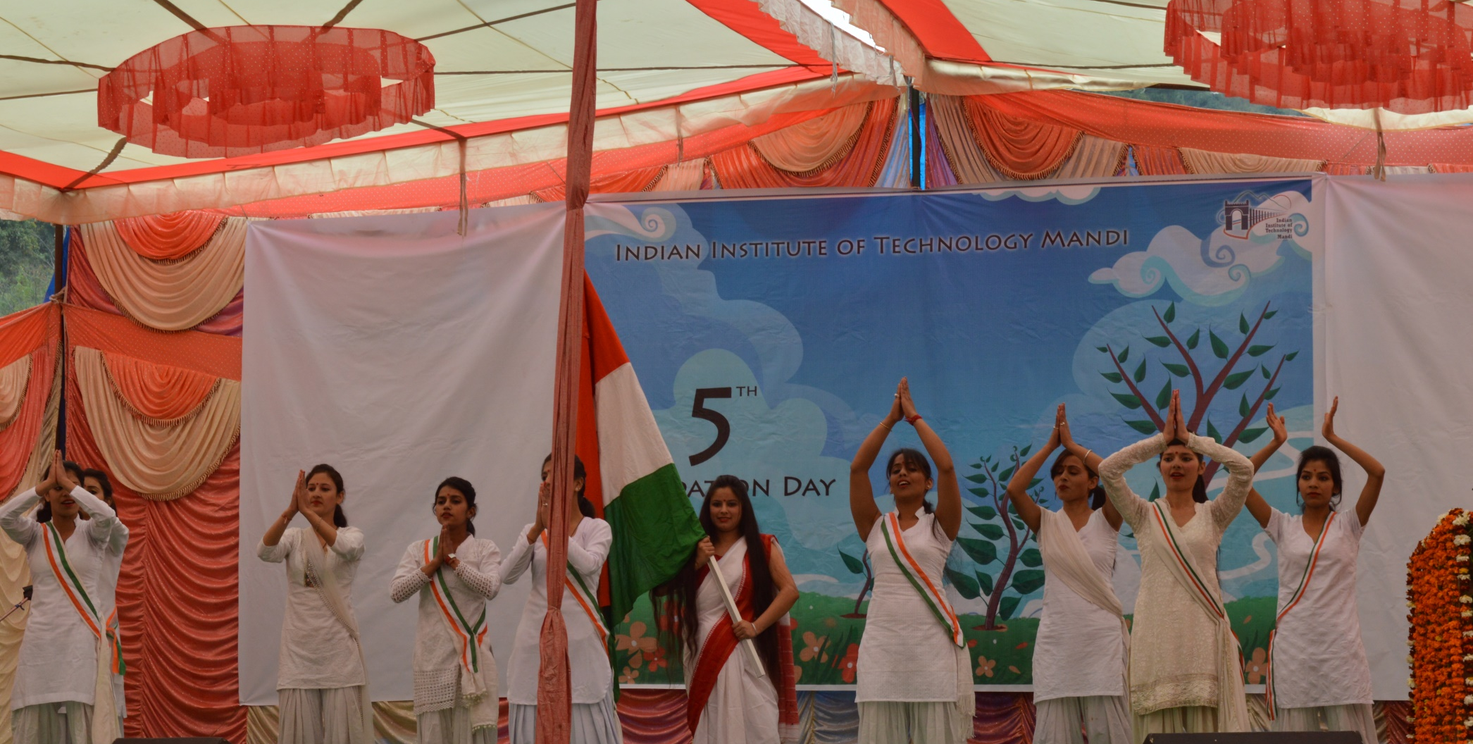
5th Foundation Day-2014
Dance Performance by Students of VGC Mandi

Slide 17
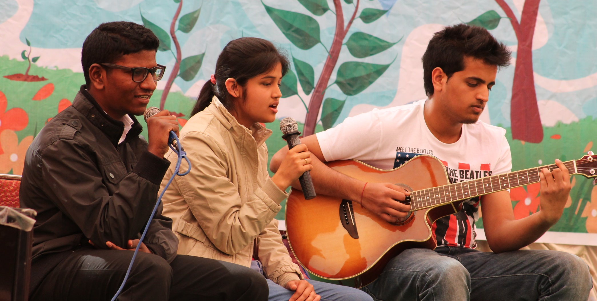
5th Foundation Day-2014
Students Singing Song- B.Tech. Students

Slide 18
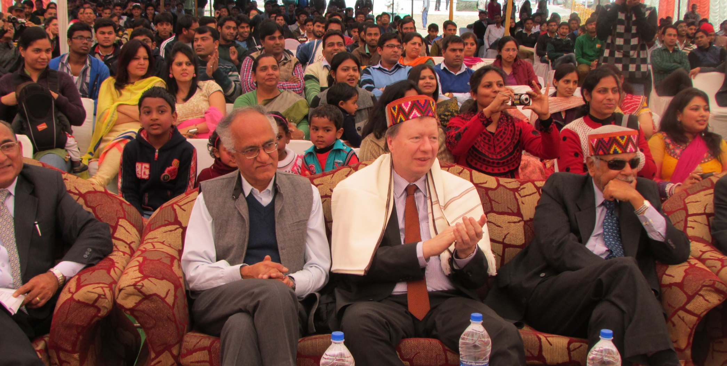
5th Foundation Day-2014
L-R Prof. Timothy A. Gonsalves, Dr. Ing Wolfram Ressel, Mr. Dinesh Kumar Jain, IIT Mandi Faculty and Staff

Slide 19
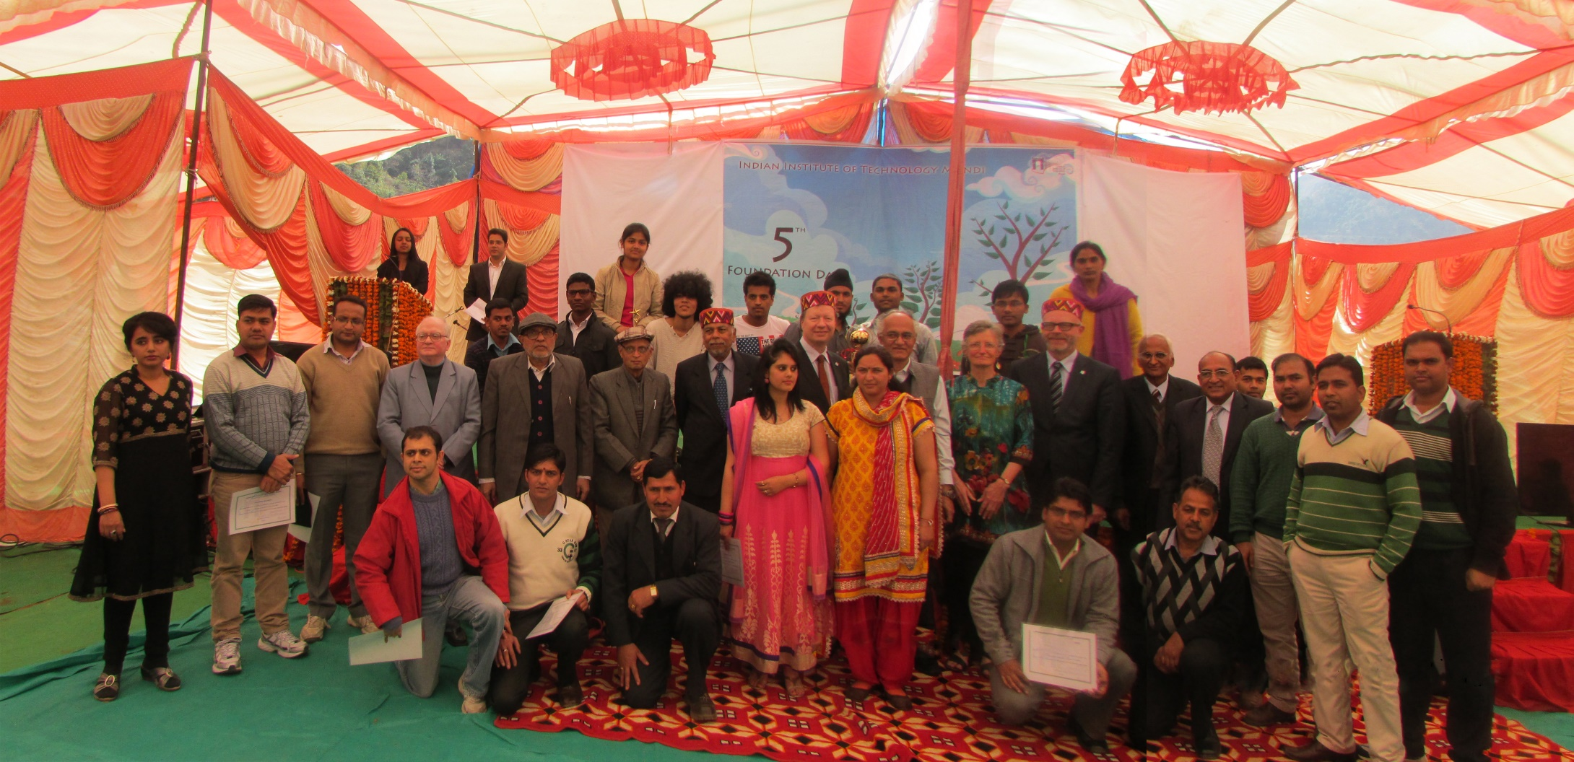
5th Foundation Day-2014
Group picture - IIT Mandi Staff, Faculty and Students

Slide 20
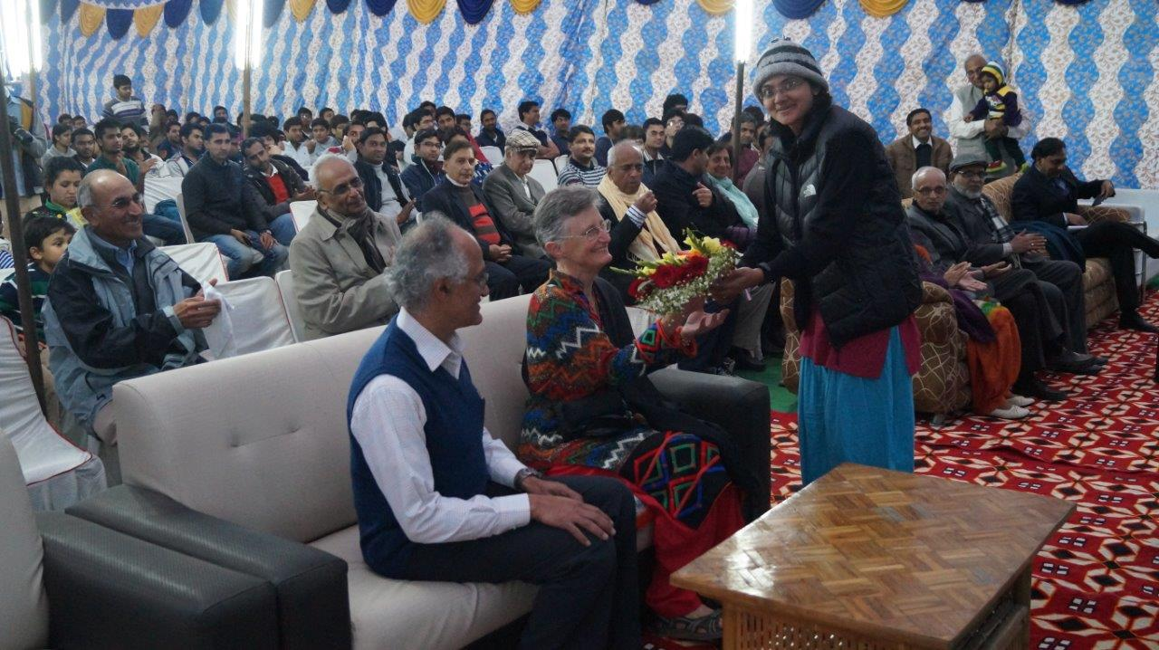
6th Foundation Day-2015
Chief Guest Welcome

Slide 21
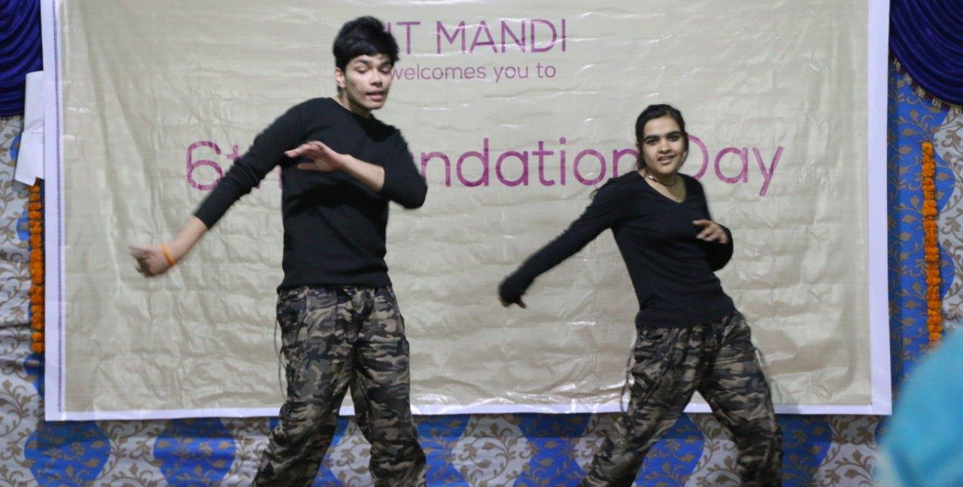
6th Foundation Day-2015
Students Dance Performance

Slide 22
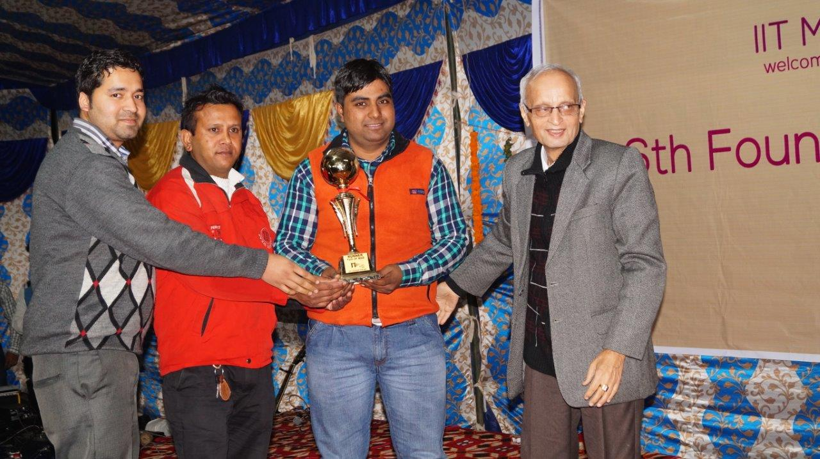
6th Foundation Day-2015
Award Distribution by Prof. Lalit Malhotra

Slide 23
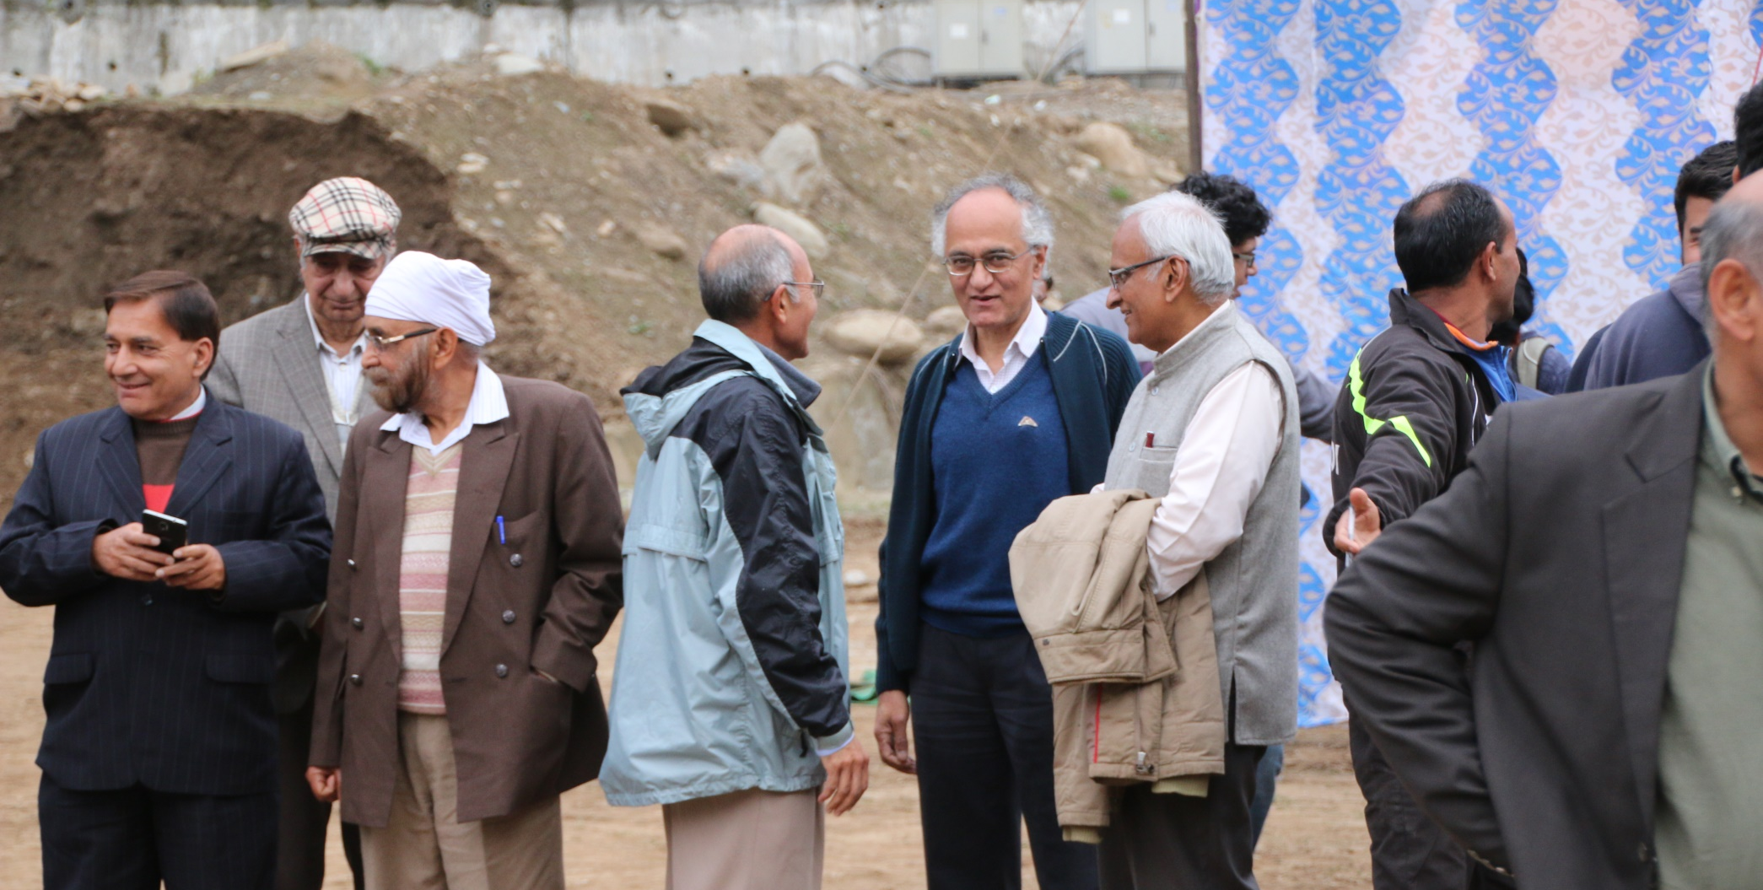
6th Foundation Day-2015
IIT Mandi Campus Community

Slide 24
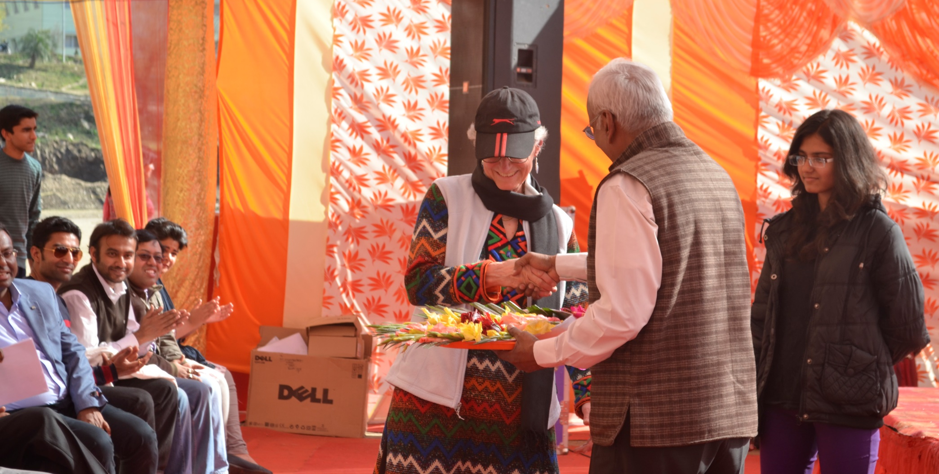
7th Foundation Day-2016
Prof. Ramesh Oruganti welcoming Dr. Priscilla Gonsalves

Slide 25
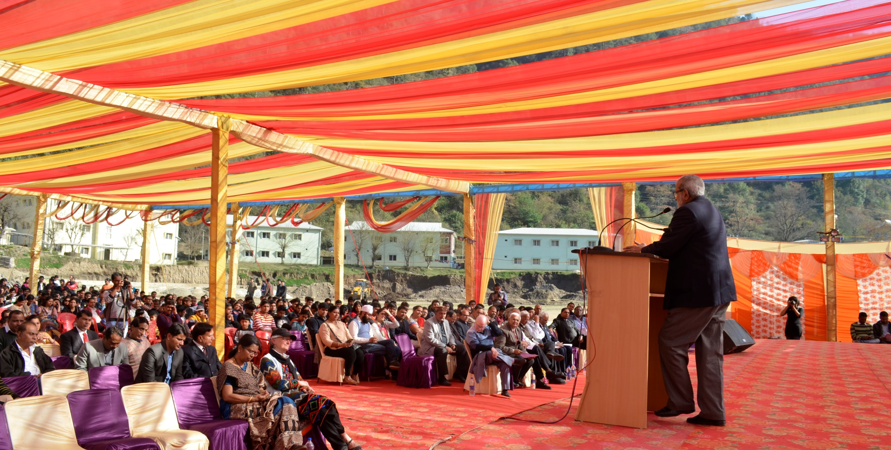
7th Foundation Day-2016
Speech by Prof. Subrata Ray

Slide 26
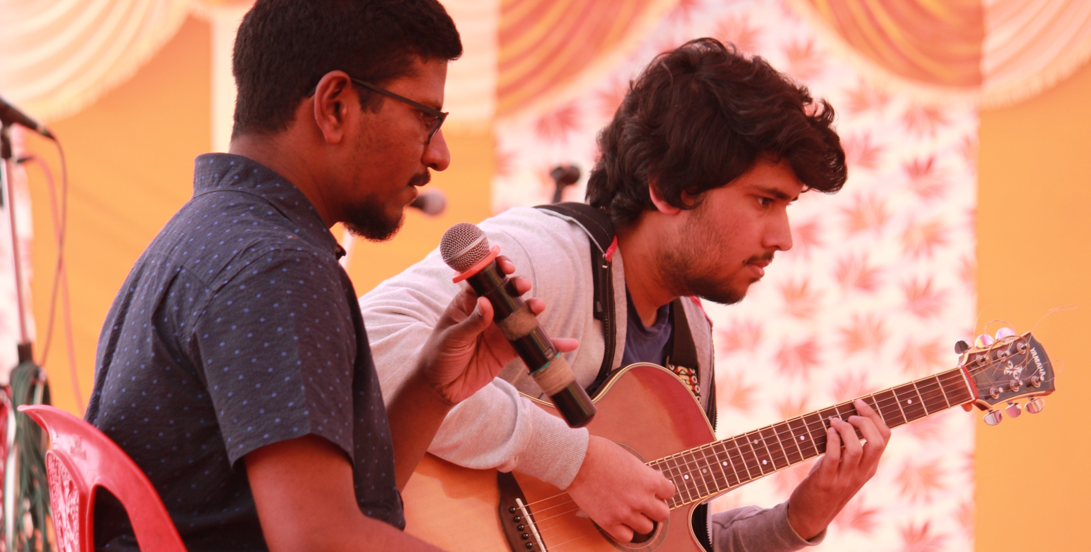
7th Foundation Day-2016
Musical performance by students

Slide 27
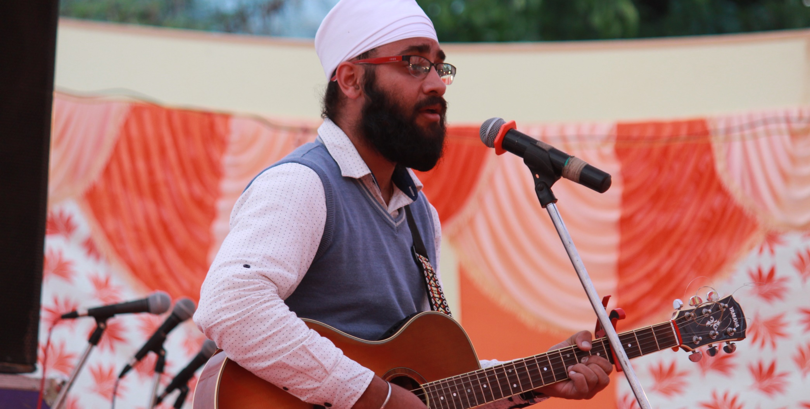
7th Foundation Day-2016
Guitar performance by Dr. Puran Singh

Slide 28
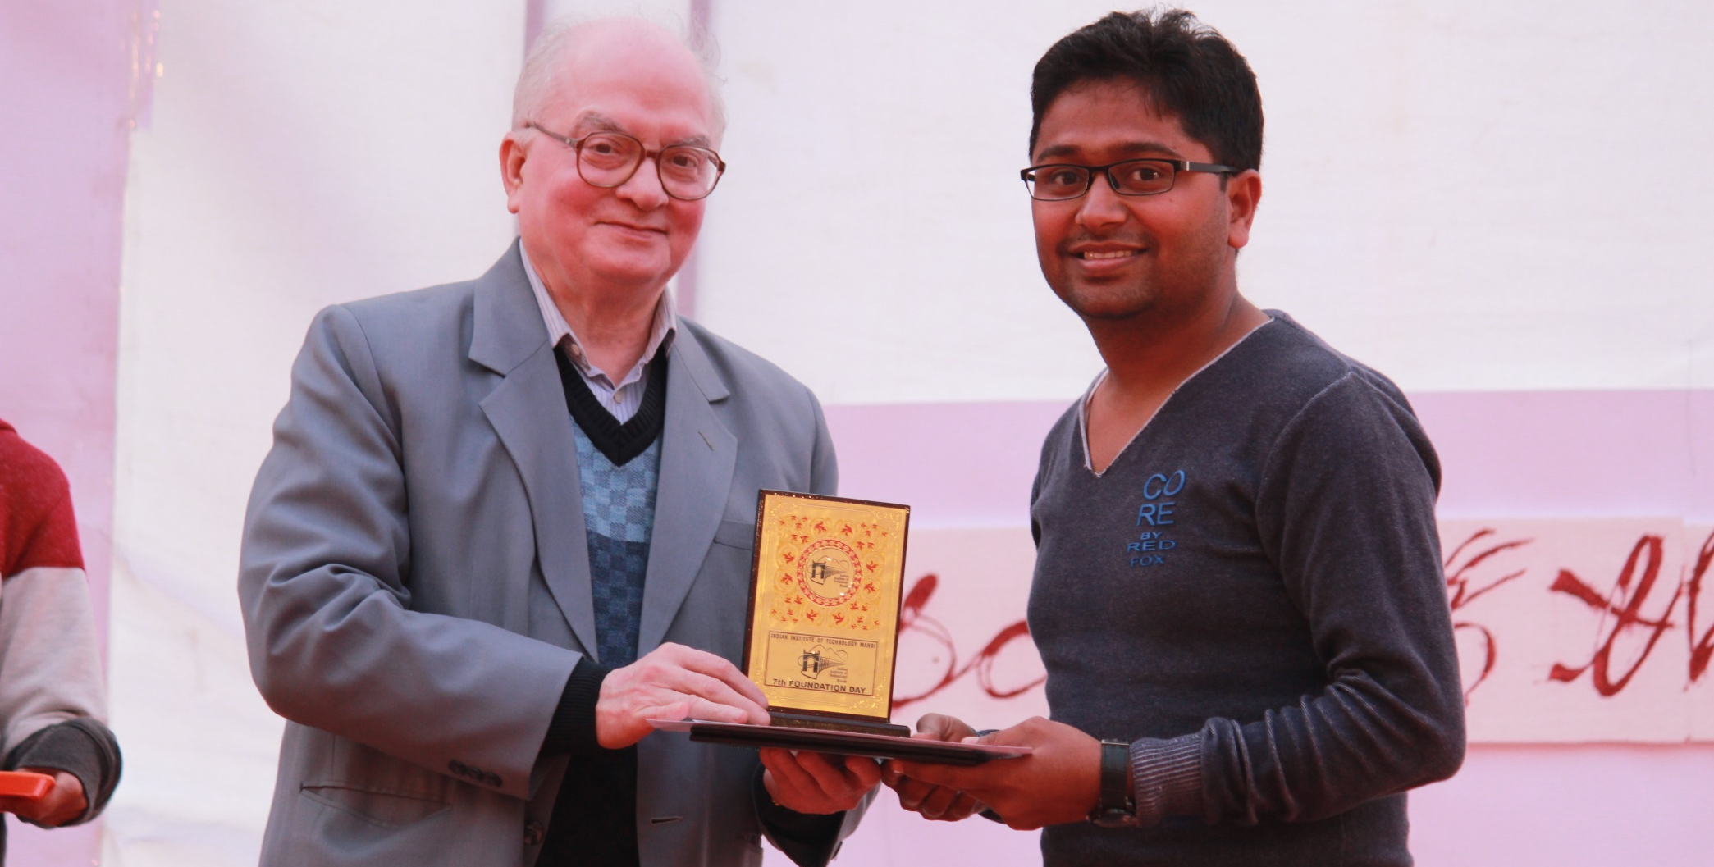
7th Foundation Day-2016
Prize distribution by Prof. B.D. Chaudhary

Slide 29
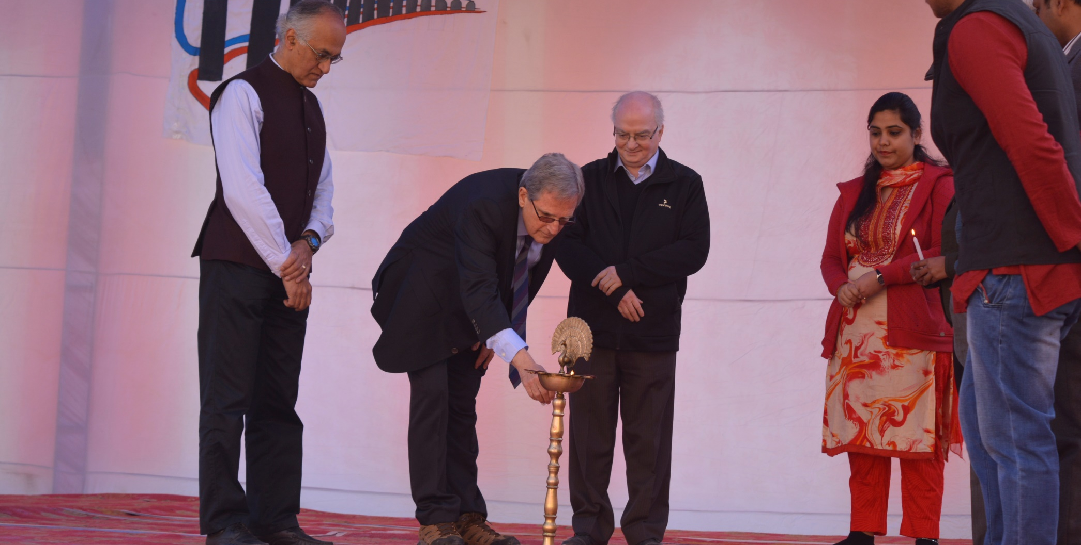
8th Foundation Day-2017
Lamp lightning BY Dr. Alan Mickelson

Slide 30
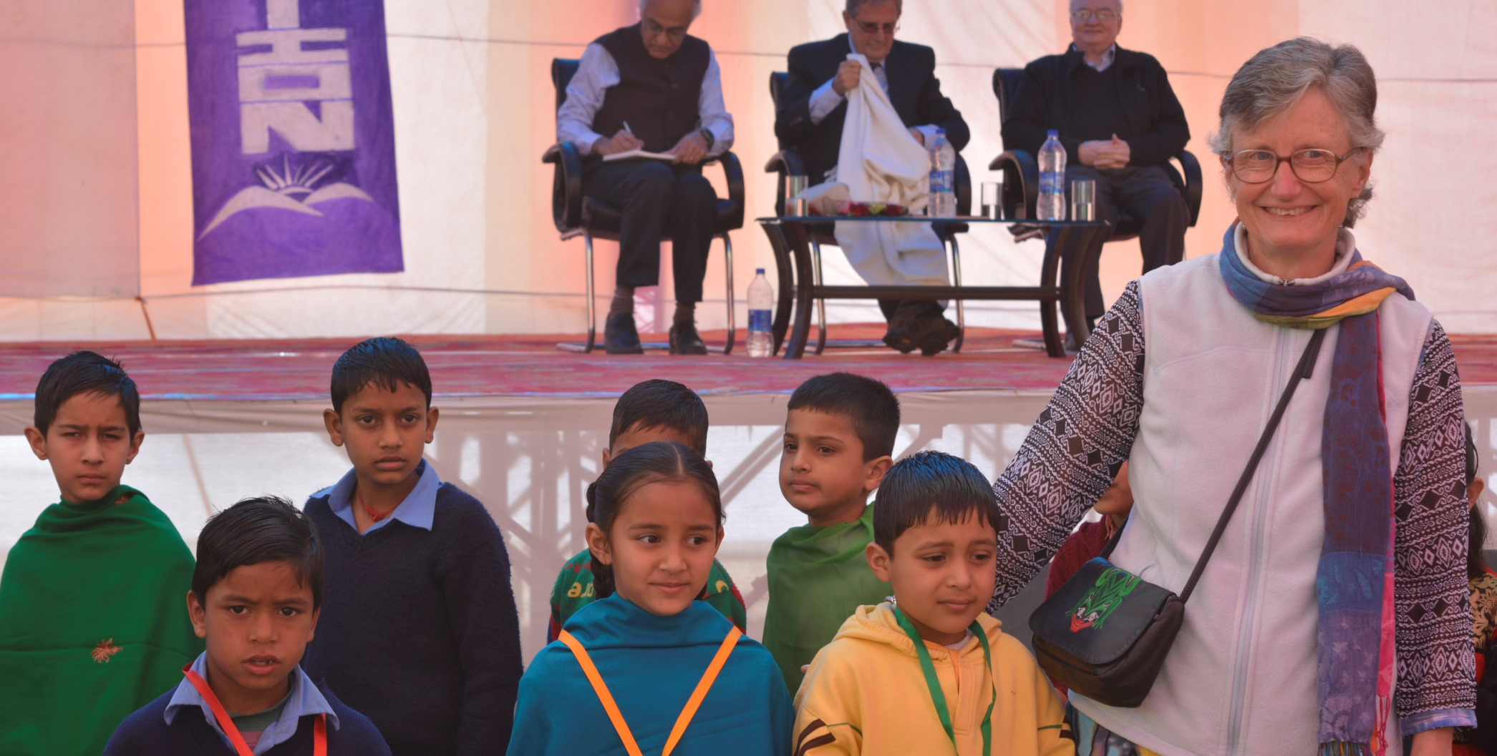
8th Foundation Day-2017
Medal distribution by Dr. Priscilla Gonsalves

Slide 31
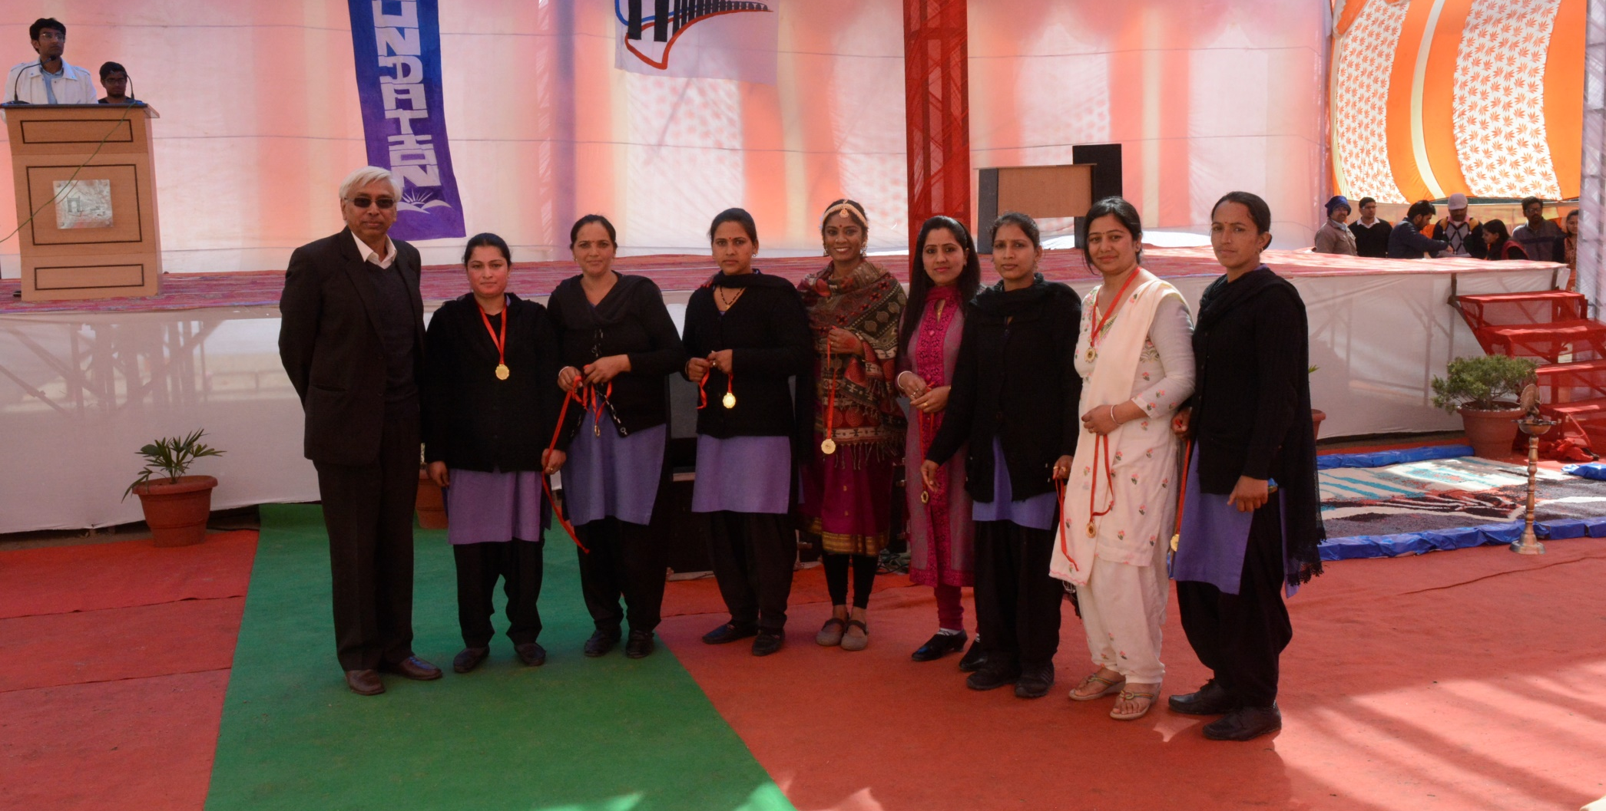
8th Foundation Day-2017
Medal distribution by Dr. Bringi Dev

Slide 32
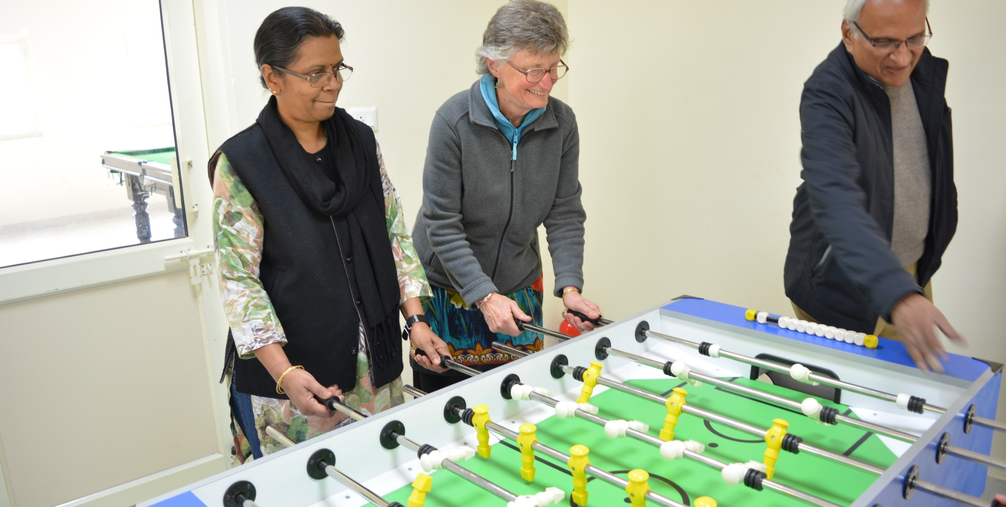
8th Foundation Day-2017
Fussball game during Sports Week

Slide 33
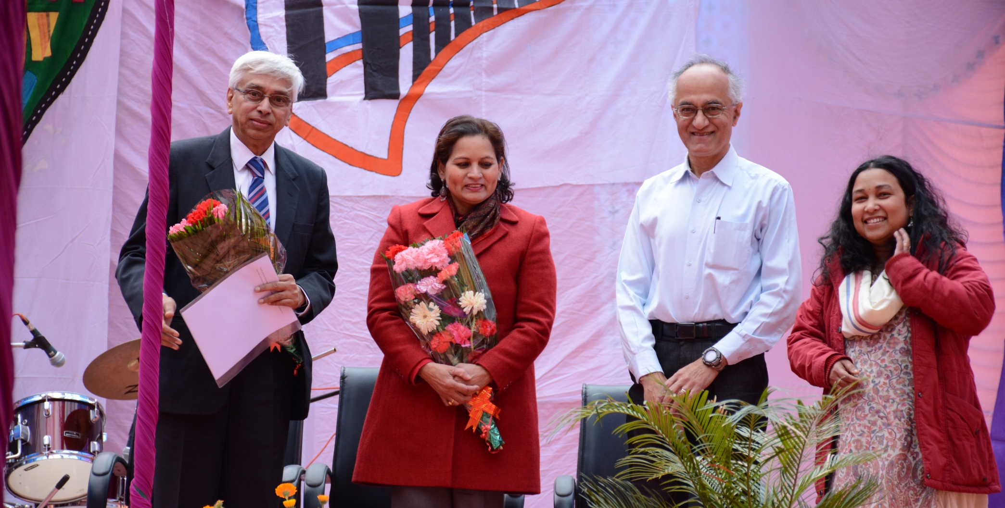
9th Foundation Day-2018
Welcome of Guest -Dr. Bringi Dev and Dr. Hema Sharda being felicitated

Slide 34
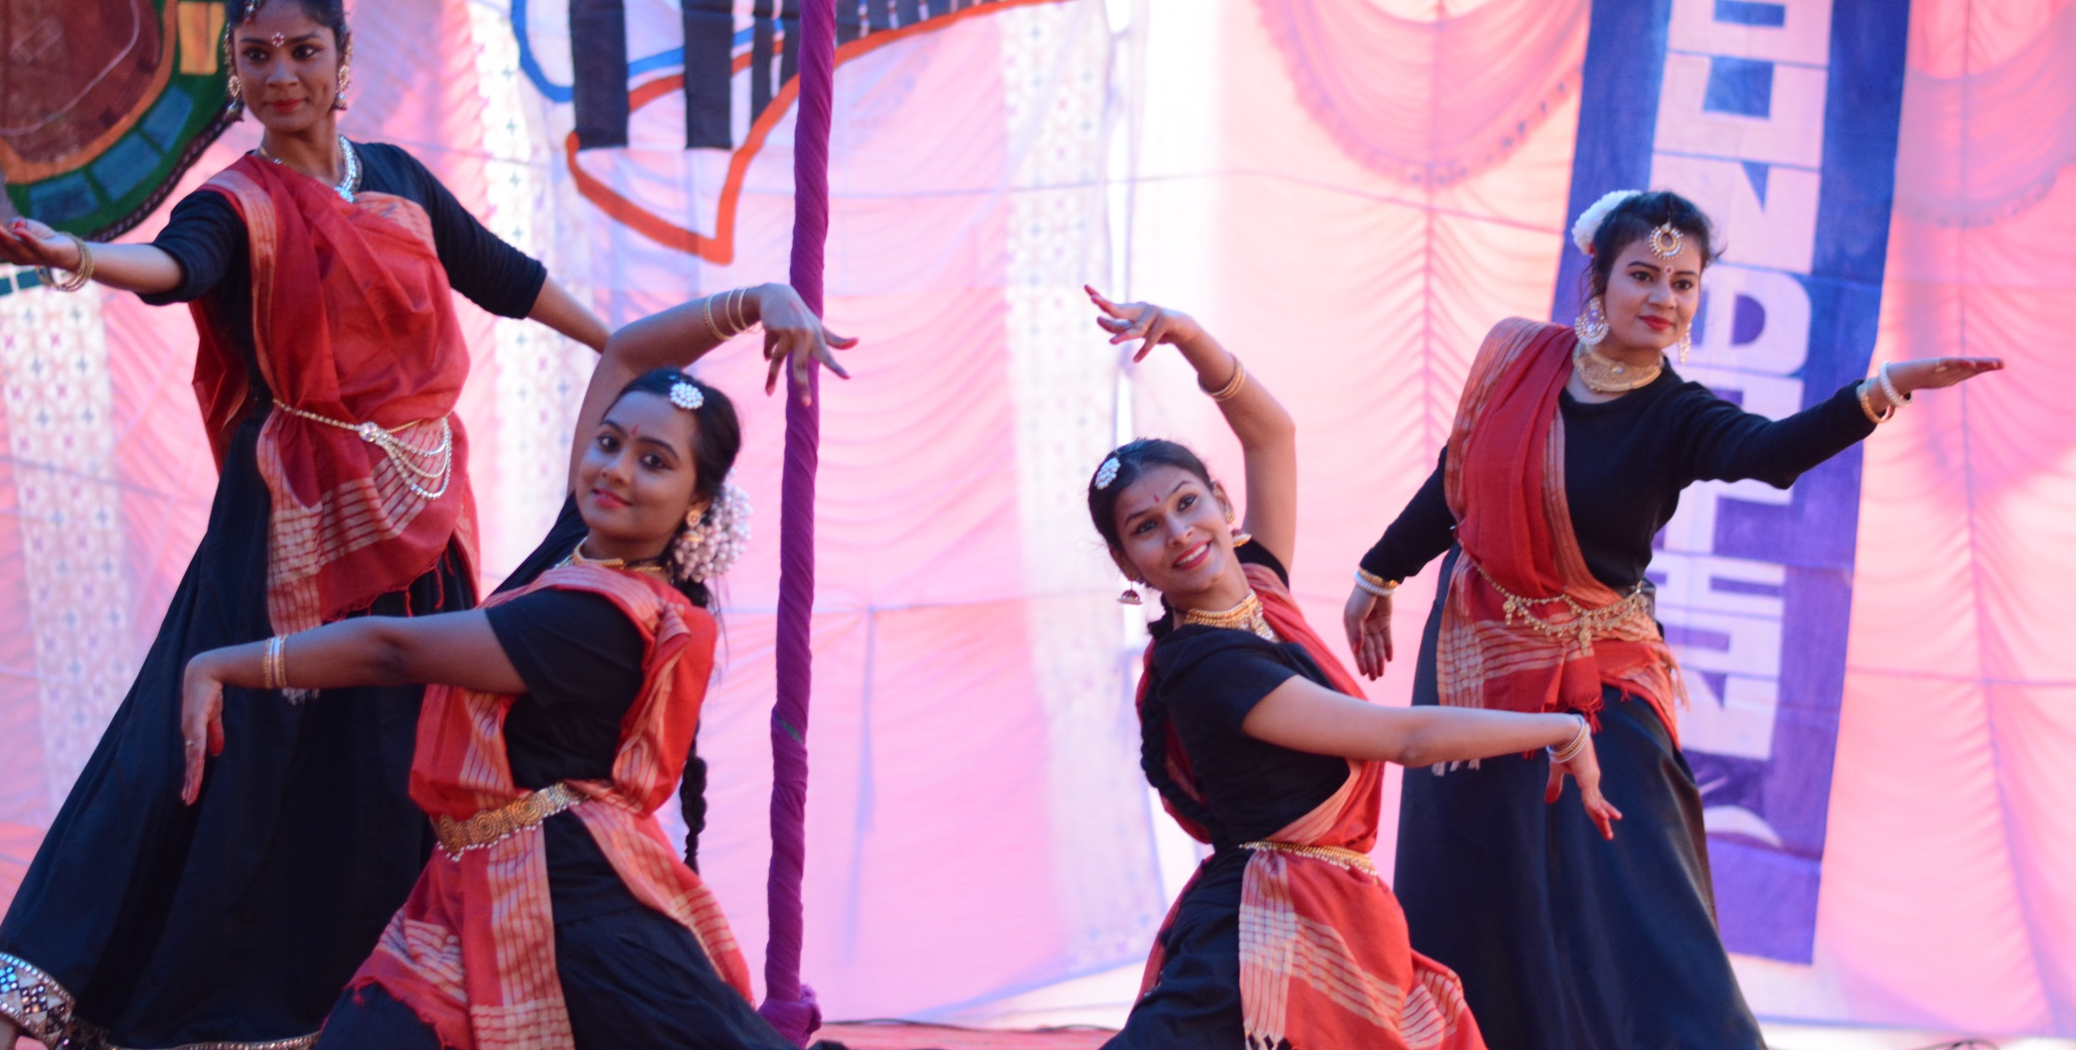
9th Foundation Day-2018
Dance performance

Slide 35
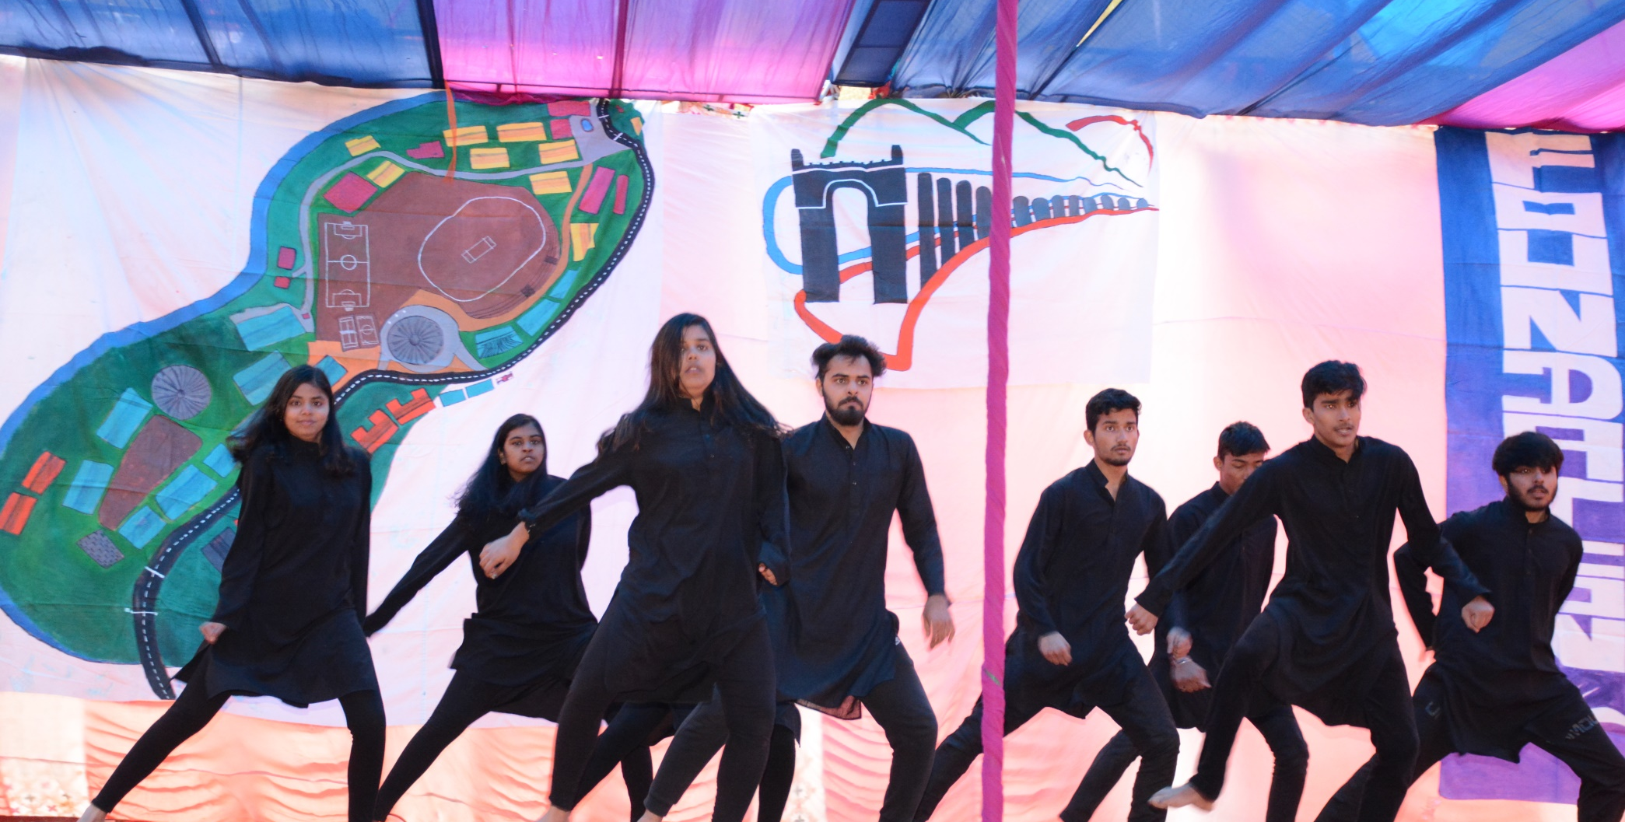
9th Foundation Day-2018
Dance performance by B.Tech. students

Slide 36
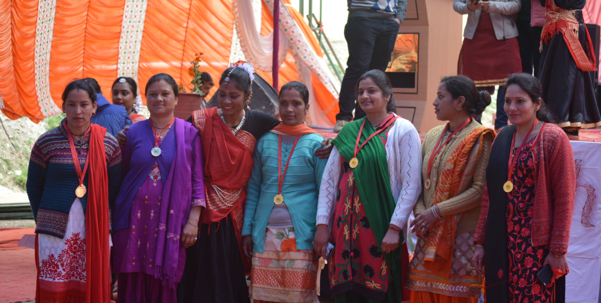
9th Foundation Day-2018
Group picture of medal winners

Slide 37
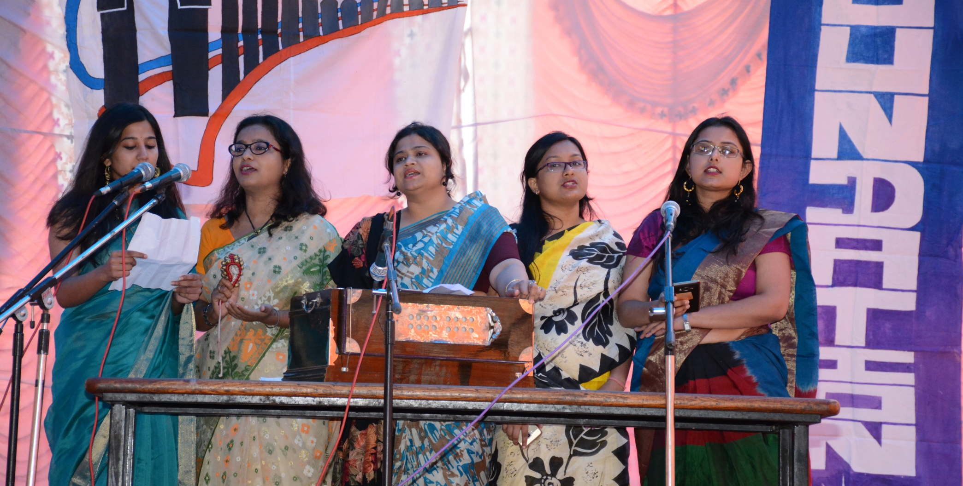
9th Foundation Day-2018
Musical performance

Slide 38
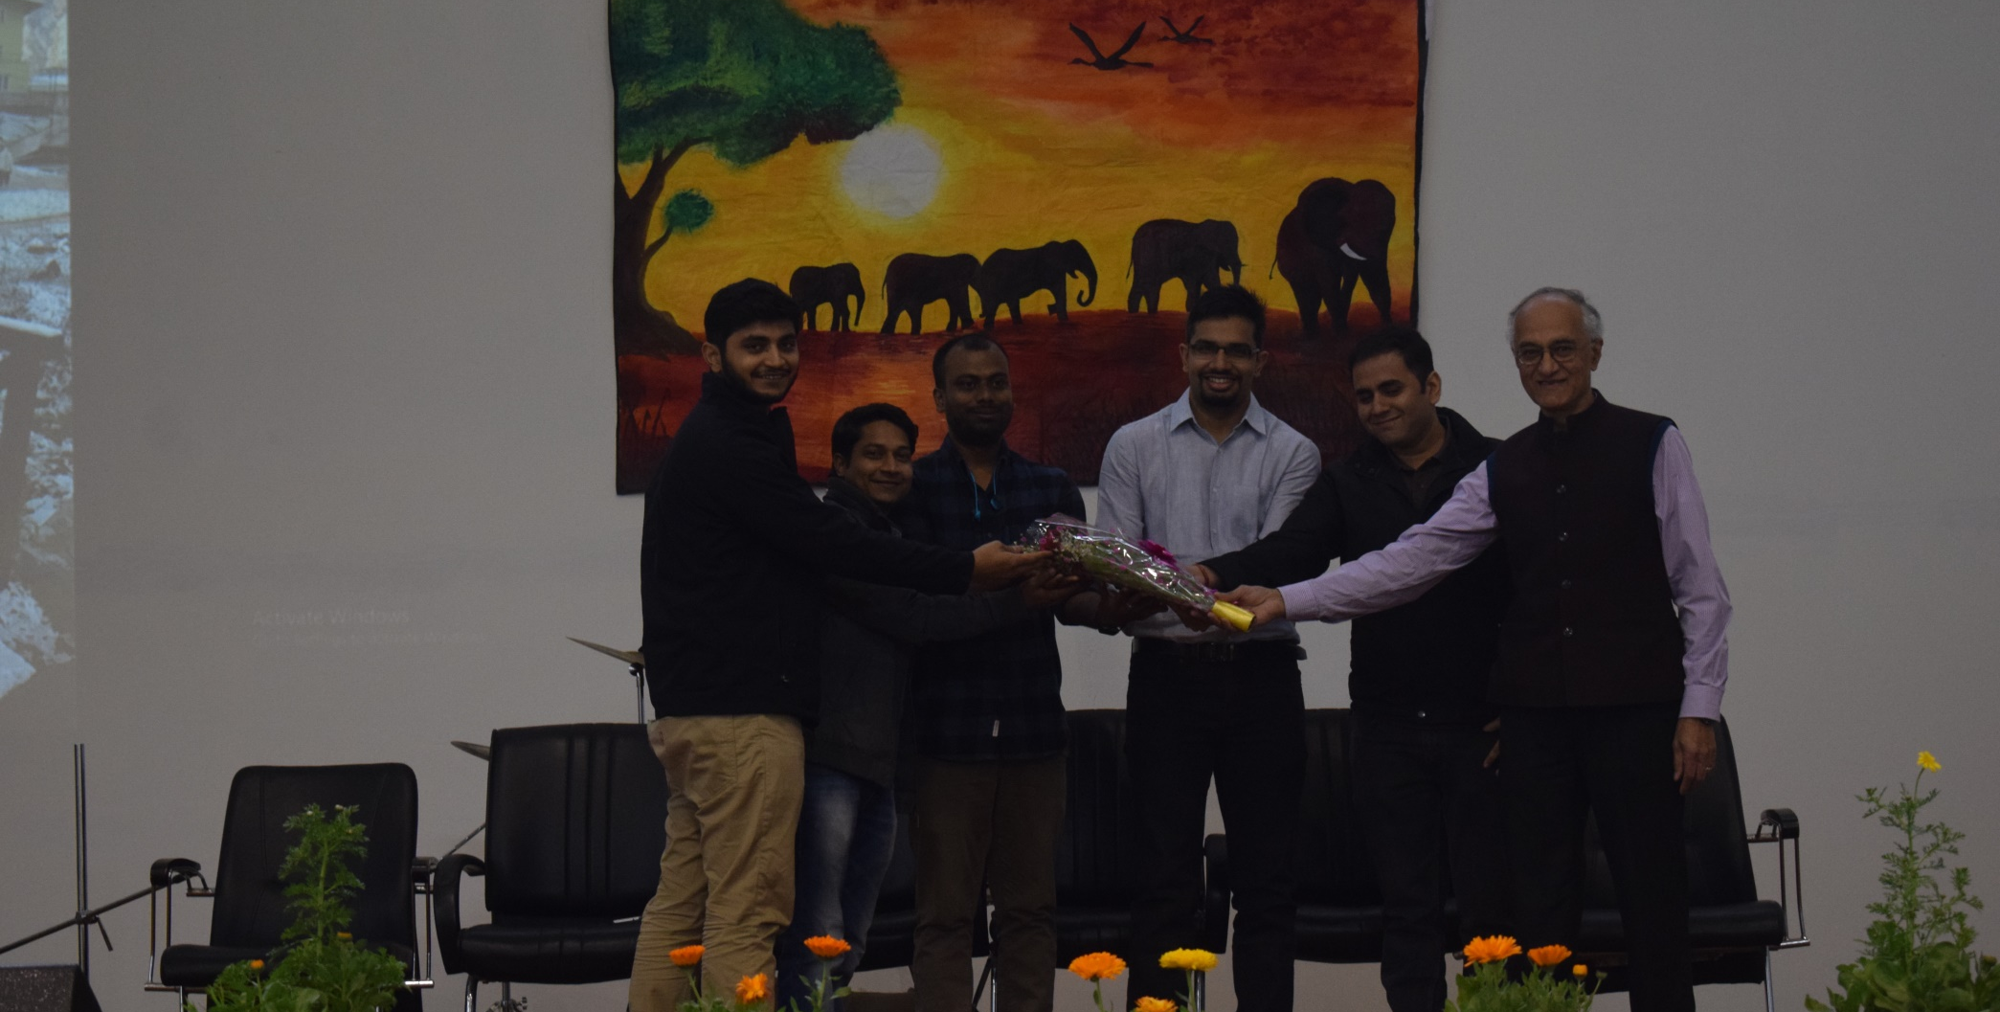
10th Foundation Day-2019
Welcome of Chief guest (1st Batch Students)

Slide 39
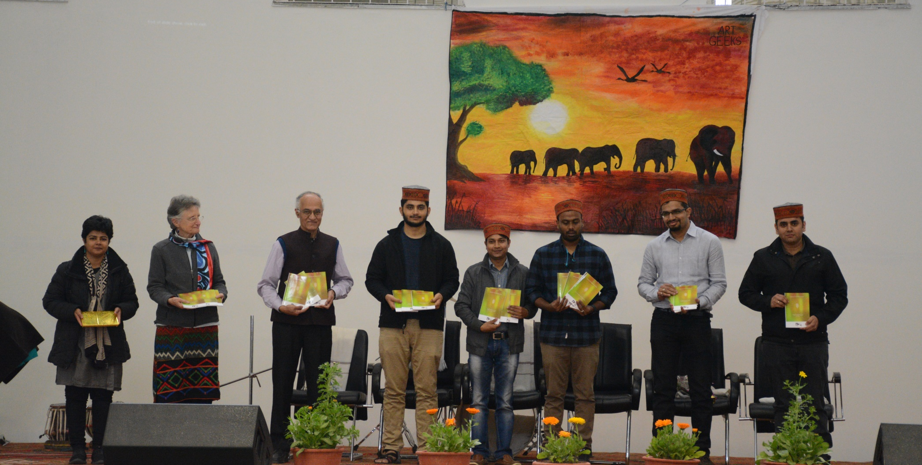
10th Foundation Day-2019
Group picture with Chief guest

Slide 40
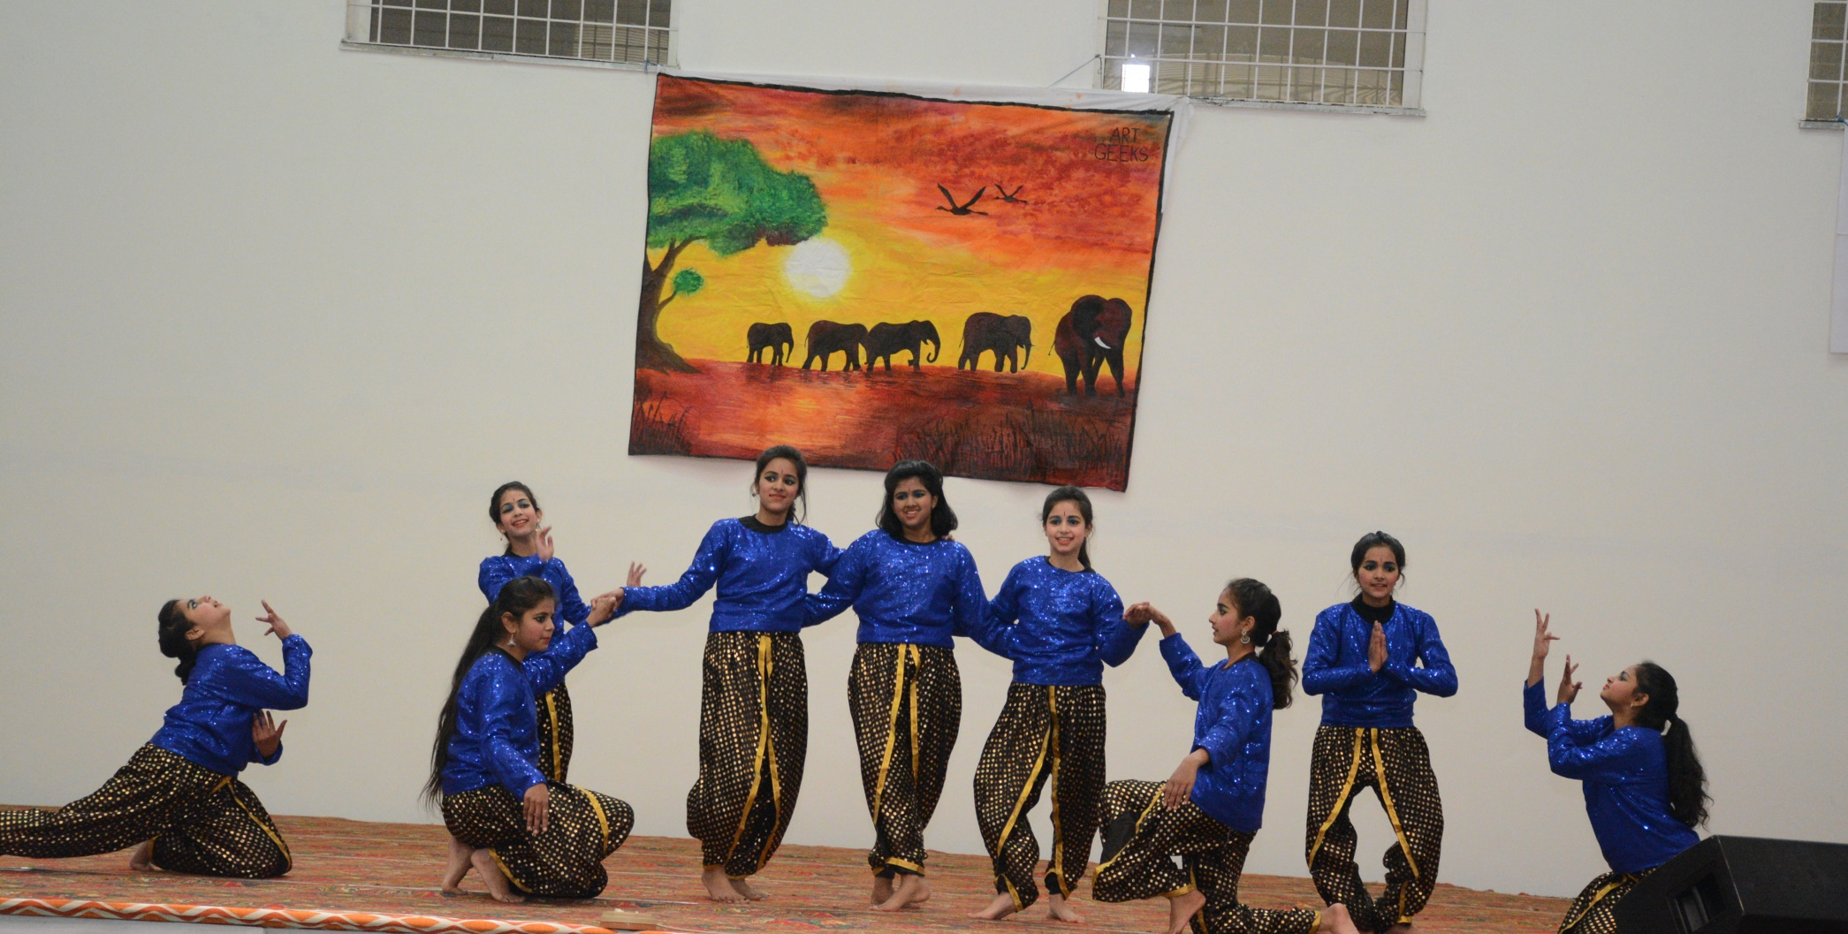
10th Foundation Day-2019
Dance performance by Mind Tree girls

Slide 41
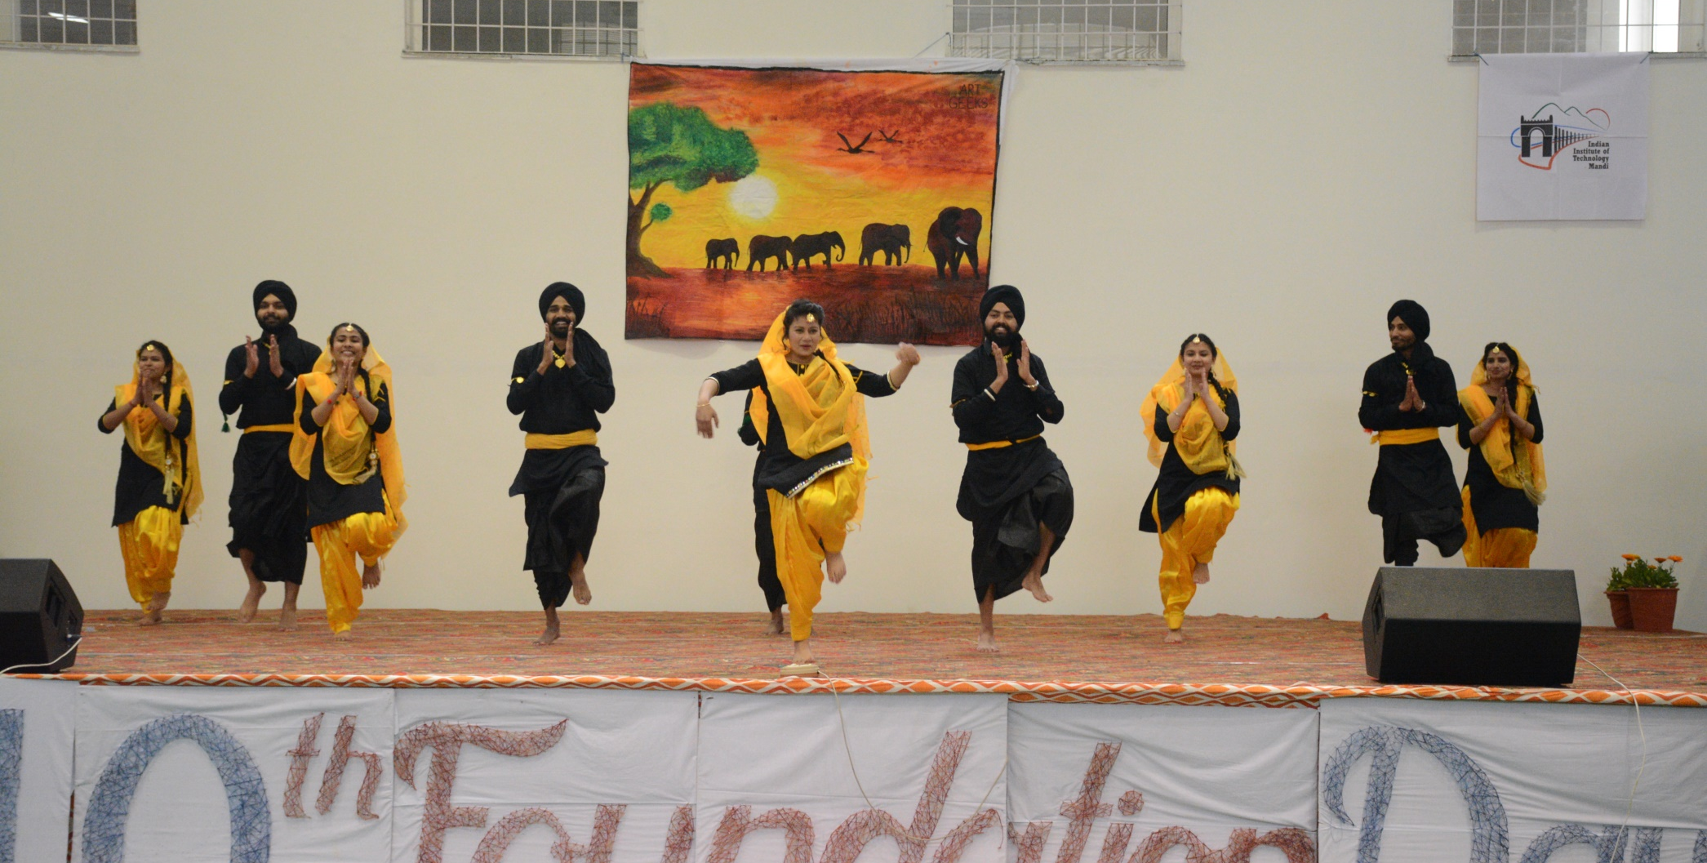
10th Foundation Day-2019
Bhangra by Students

Slide 42
Archives Team:
Dr. Astrid Kiehn
Mr. Naresh Singh Bhandari
Dr. Rajeshwari Dutt
Dr. Devika Sethi
Ms. Anju (Project Associate)
Ms. Jyoti Sharma (Student)
Mr. Debanshu Shrivastava (Student)

